Slide 1
SECURE DATA HIDING IN IMAGE USING STEGANOGRAPHY
CAPSTONE PROJECT
Presented By:
Student Name : Prabjyot Singh
College Name & Department : Mahant Bachittar Singh College of Engineering and Technology (Computer Science and Engineering)

Slide 2
OUTLINE
Problem Statement
Technology used
Wow factor
End users
Result
Conclusion
Git-hub Link
Future scope

Slide 3
Problem Statement
Develop a steganographic technique to securely hide and retrieve sensitive information within an image. The hidden data should be imperceptible to the human eye, maintain the quality of the host image, and be resistant to unauthorized extraction and common image manipulation.

Slide 4
Technology used
SOFTWARE REQUIREMENTS:
Python (3.x version): Ensure you have the latest version installed.
Integrated Development Environment (IDE): Such as PyCharm, VSCode, or Jupyter Notebook.
Libraries:
OpenCV (For image processing tasks)
Pickle (For serialization and deserialization of Python objects)
OS (Built-in with Python, for interacting with the operating system)
HARDWARE REQUIREMENTS:
Processor: A modern processor (Intel i5/AMD Ryzen 5 or higher) for efficient processing.
RAM: Minimum 4 GB (8 GB or more recommended for better performance).
Storage: At least 500 MB of free space for the project files and libraries.

Slide 5
Wow factors
Dynamic Encryption: Ensures hidden data security.
Pixel-Level Manipulation: Imperceptible changes.
User Input Integration: Personalized messages and passcodes.
Data Integrity: Keeps the hidden message unchanged.
Platform Compatibility: Runs on multiple operating systems.
Ease of Use: Simple, user-friendly interface.
Educational Value: Great learning tool for steganography and image processing.

Slide 6
End users
Intellectual Property Owners: Protecting copyright and embedding hidden watermarks in digital assets.
Defense and Military: Securing sensitive military communications and information within images.
Software Developers: Building applications that incorporate steganography for added security features.
Educators and Students: Those using the project as a learning tool to understand steganography, encryption, and image processing concepts.
Healthcare Providers: Embedding patient information securely within medical images to ensure privacy and confidentiality.
Government Agencies: Securing confidential government communications and documents with hidden data techniques.

Slide 7
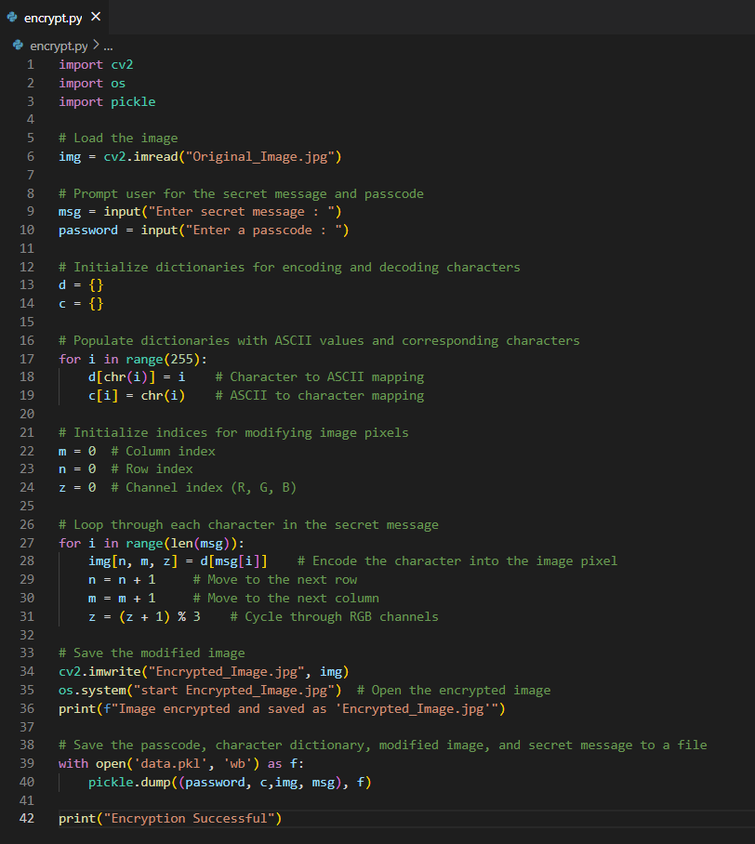
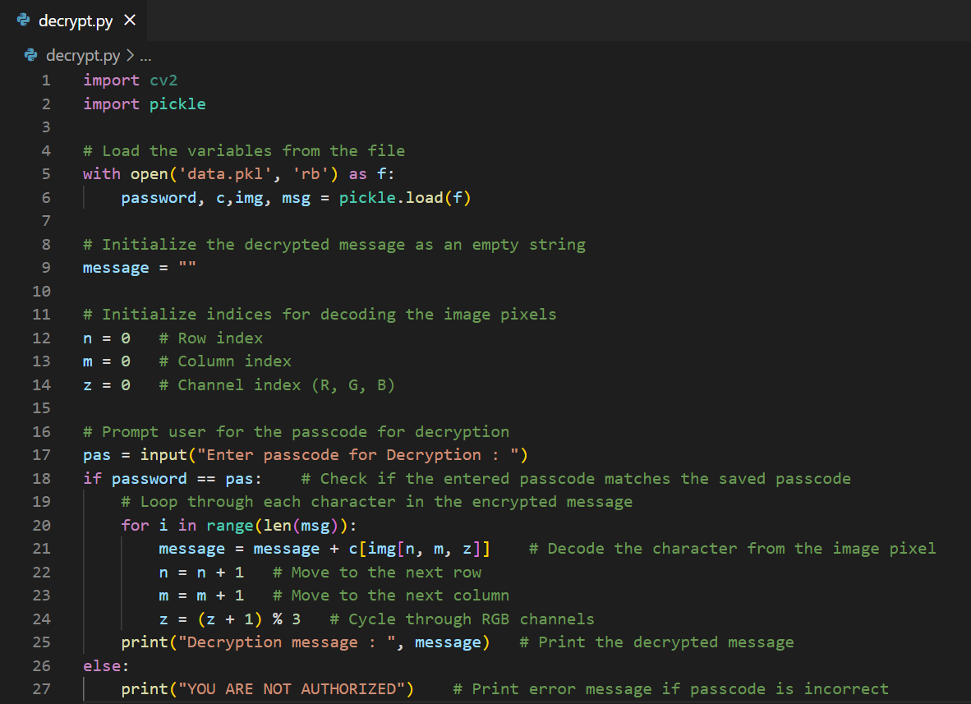
Results
Encryption code ( encrypt.py ) :
Decryption code ( decrypt.py ) :

Slide 8
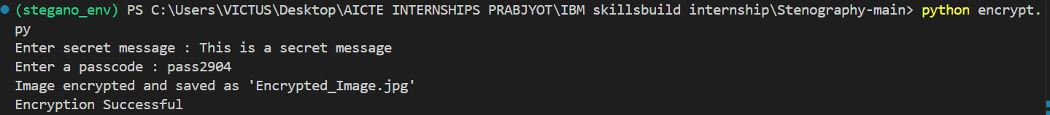


Encrypt.py output :
Decrypt.py output :
Original Image :
Encrypted Image :

Slide 9
Conclusion
This project effectively addresses the challenge of securely hiding sensitive data within digital images using steganography.
By developing an algorithm that embeds data seamlessly without compromising image quality, and incorporating dynamic encryption, it ensures robustness against image processing techniques.
The user-friendly interface and cross-channel encoding enhance the project's practicality and accessibility for various users, from individuals to security agencies.
In essence, the project successfully balances data capacity, security, and image fidelity, meeting the goals outlined in the problem statement.

Slide 10
GitHub Link
https://github.com/PrabjyotSingh2904/Secure-Data-Hiding-In-Image-Using-Steganography.git

Slide 11
Future scope
Enhanced Security: Integrate more advanced encryption algorithms to further improve data security and robustness against sophisticated attacks.
Increased Data Capacity: Develop methods to embed larger amounts of data without compromising image quality, such as adaptive or multi-level steganography.
Machine Learning Integration: Use machine learning models to optimize data embedding and extraction processes, improving efficiency and effectiveness.
User-Friendly Applications: Create user-friendly software or mobile applications that allow easy and intuitive use of steganography for non-technical users.
Interdisciplinary Applications: Explore applications in fields such as medical imaging, digital forensics, and intellectual property protection to enhance data security and privacy.

Slide 12
THANK YOU

